Slide 1

Walmart Sales Analysis Using SQL
Present By Sudarshan Kamthe under
Mentorness Under Batch MIP-DA-13

Slide 2
Introduction
Walmart, one of the world's largest retail corporations, operates an extensive network of stores and e-commerce platforms, generating vast amounts of sales data.
Analyzing this data is essential to understanding key metrics such as sales trends, customer preferences, and overall business performance.
This presentation aims to provide insights into Walmart's sales operations, focusing on total revenue, product line performance, and customer demographics.
By leveraging these insights, Walmart can enhance its operational efficiency, identify growth opportunities, and make data-driven decisions to improve customer satisfaction and profitability.

Slide 3
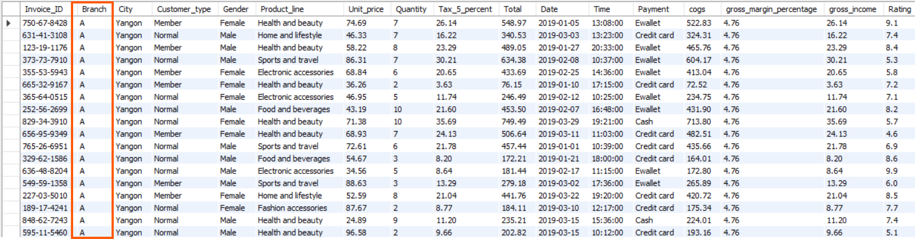
Retrieve all columns for sales made in a specific branch (e.g., Branch 'A').
Query ->
SELECT * FROM transactions
WHERE Branch = 'A';
Result ->

Slide 4
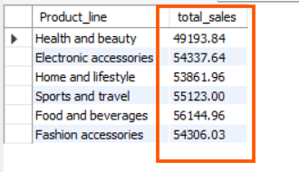
2. Find the total sales for each product line.
Query ->
SELECT
Product_line, ROUND(SUM(Total), 2) AS total_sales
FROM
transactions
GROUP BY Product_line;
Result ->

Slide 5
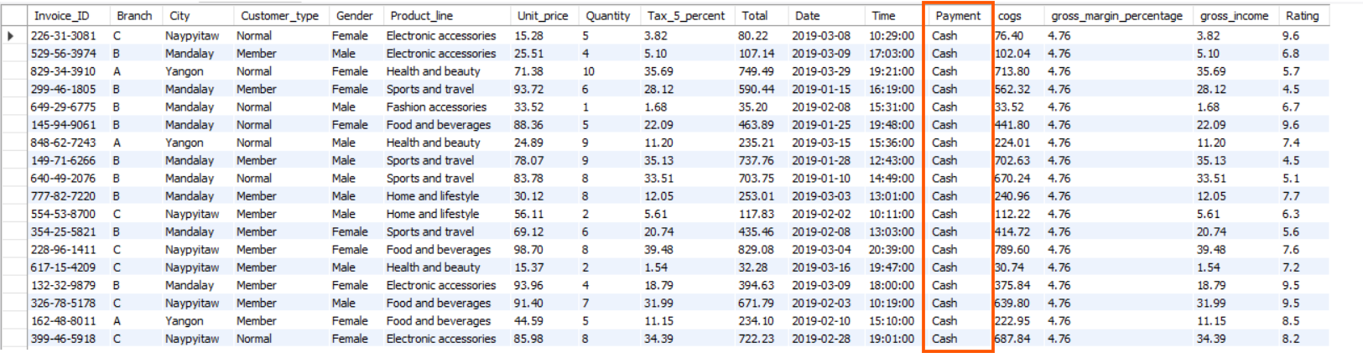
3. List all sales transactions where the payment method was 'Cash'.
Query ->
SELECT * FROM transactions
where Payment='Cash';
Result ->

Slide 6
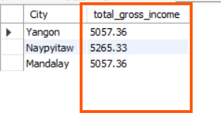
4. Calculate the total gross income generated in each city.
Query ->
SELECT City,
round(sum(gross_income),2) AS total_gross_income
FROM
transactions
GROUP BY
City;
Result ->

Slide 7
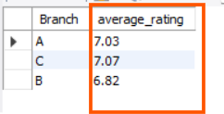
5.Find the average rating given by customers in each branch.
Query ->
SELECT Branch,
round(avg(rating),2) AS average_rating
FROM
transactions
GROUP BY Branch;
Result ->

Slide 8
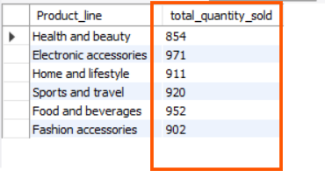
6. Determine the total quantity of each product line sold.
Query ->
SELECT Product_line,
sum(quantity) AS total_quantity_sold
FROM
transactions
GROUP BY Product_line;
Result ->

Slide 9
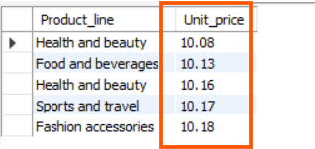
7. List the top 5 products by unit price.
Query ->
SELECT Product_line, Unit_price
FROM transactions
ORDER BY Unit_price LIMIT 5;
Result ->

Slide 10
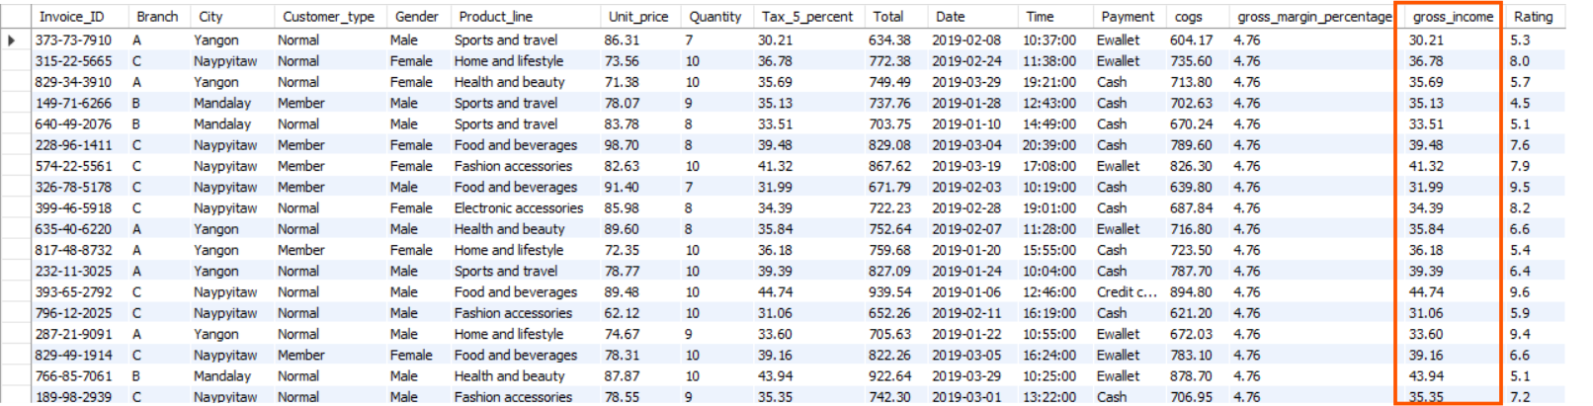
8.Find sales transactions with a gross income greater than 30
Query ->
SELECT * FROM transactions
WHERE gross_income > 30;
Result ->

Slide 11
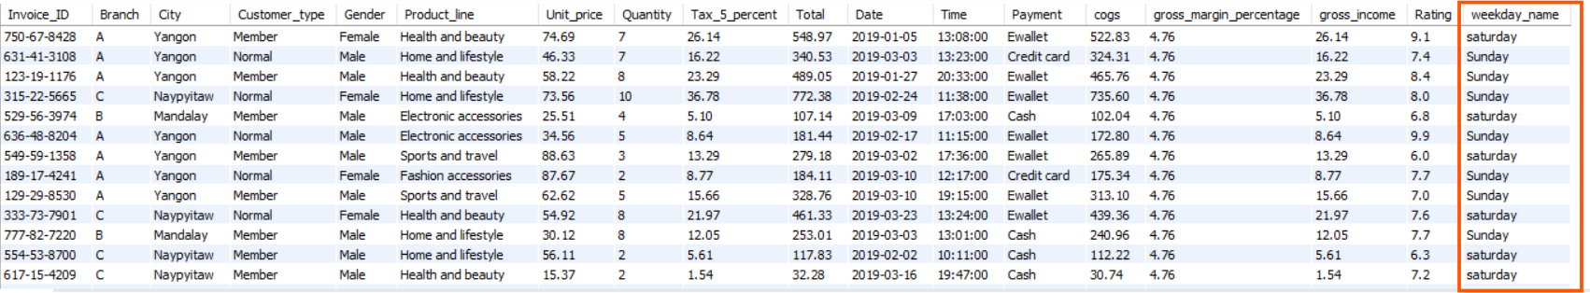
9.Retrieve sales transactions that occurred on weekends.
Query ->
SELECT *,
CASE
WHEN DAYOFWEEK(Date) = 1 THEN 'Sunday'
WHEN DAYOFWEEK(Date) = 7 THEN 'saturday'
END AS weekday_name
FROM
transactions
WHERE DAYOFWEEK(Date) IN (1 , 7);
Result ->

Slide 12
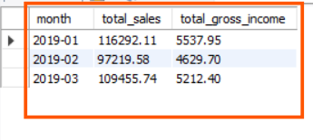
10. Calculate the total sales and gross income for each month.
Query ->
SELECT
DATE_FORMAT(STR_TO_DATE(Date, '%Y-%m-%d'), '%Y-%m') AS month,
ROUND(SUM(Total), 2) AS total_sales,
ROUND(SUM(gross_income), 2) AS total_gross_income
FROM
transactions
GROUP BY
DATE_FORMAT(STR_TO_DATE(Date, '%Y-%m-%d'), '%Y-%m’)
ORDER BY month;
Result ->

Slide 13

11.Find the number of sales transactions that occurred after 6 PM.
Query ->
SELECT COUNT(*) AS num_transactions_after_6pm
FROM transactions
WHERE TIME(Time) > '18:00:00';
Result ->

Slide 14
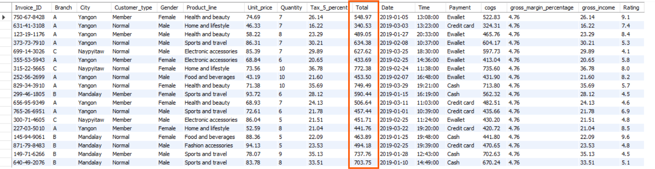
12.List the sales transactions that have a higher total than the average total of all transactions.
Query ->
select * from transactions
where Total > (SELECT avg(Total) from transactions);
Result ->

Slide 15
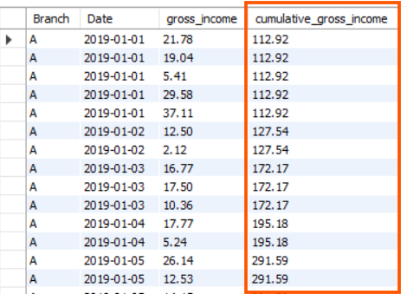
13. Calculate the cumulative gross income for each branch by date.
Query ->
SELECT Branch, Date,
gross_income,
round(sum(gross_income) OVER (PARTITION BY Branch ORDER BY Date),2)
AS cumulative_gross_income
FROM
transactions
ORDER BY
Branch, Date;
Result ->

Slide 16
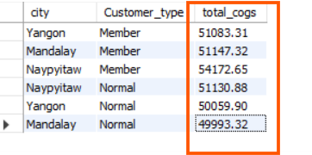
14.Find the total cogs for each customer type in each city.
Query ->
SELECT city,
Customer_type,
round(sum(cogs), 2) AS total_cogs
FROM
transactions
GROUP BY
Customer_type,
City;
Result ->

Slide 17
Conclusion
The analysis of Walmart's sales data reveals critical trends and patterns that can inform future business strategies.
Key takeaways include identifying top-performing product lines, understanding the impact of various payment methods, and recognizing the role of customer demographics in shaping purchasing behavior.
Additionally, the analysis underscores the importance of specific sales periods, such as weekends, in driving revenue.
These insights can help Walmart optimize inventory management, refine marketing strategies, and improve customer experience, ultimately leading to sustained growth and profitability.
Continuous monitoring and analysis of sales data will be vital in maintaining Walmart's competitive advantage in the retail market.

Slide 18
THANK YOU

